Slide 1
Team Save Our Site
Team Members:
Carlos Acevedo
Nathan Colyer
Kari Dunn
Nick Stewart

Slide 2
Problems Our Prototype Addresses
Donor management
Volunteer management
Event management
Patient Testimonials
Language Translation
Other features

Slide 3
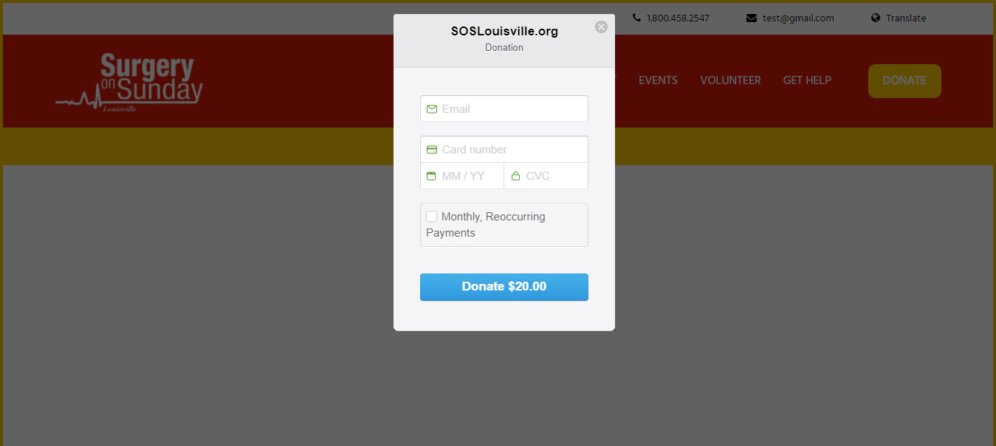
Donor Management
Donor makes a donation

Slide 4
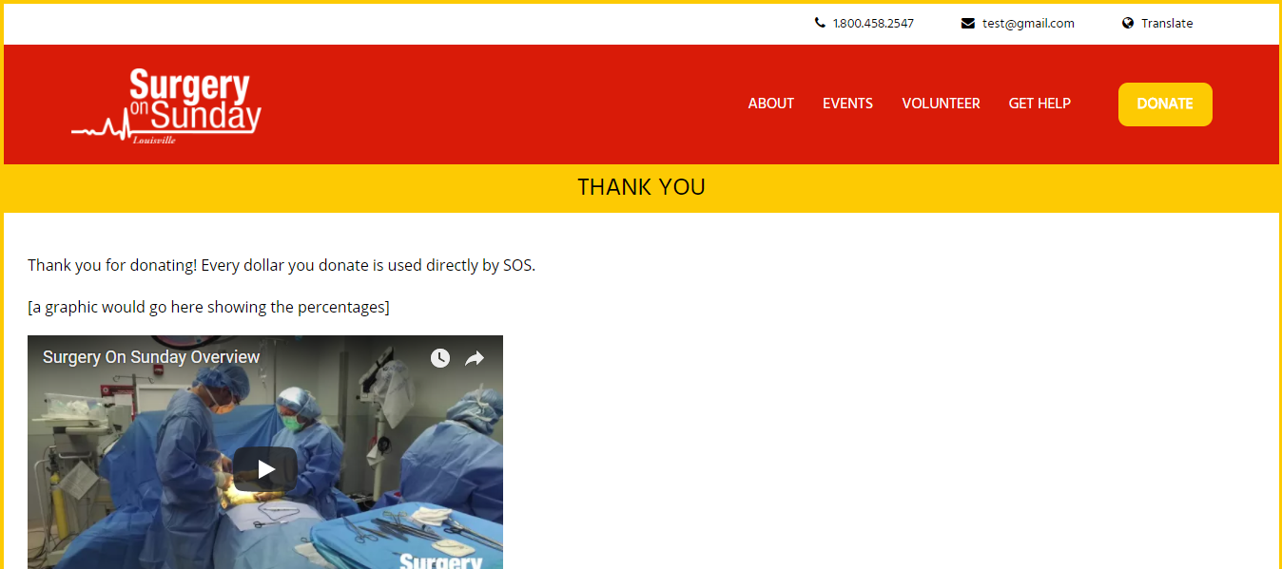
Donor Management
Donor is redirected to a thank you page after making a donation

Slide 5
Donor management
Donation Management

Slide 6
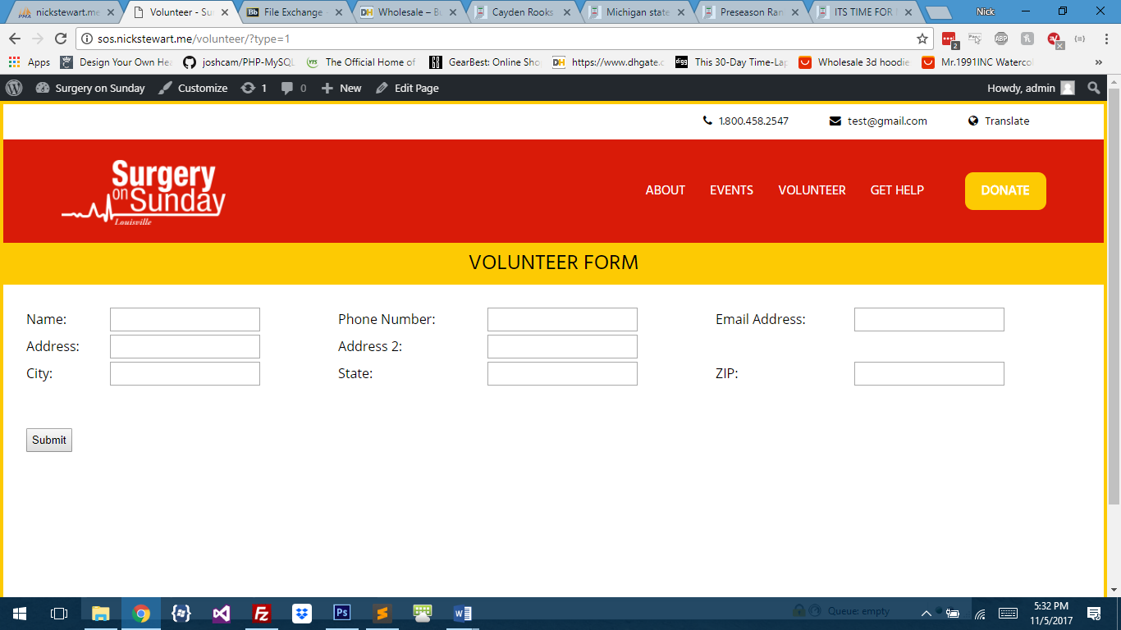
Volunteer Management
Volunteer fills out form

Slide 7
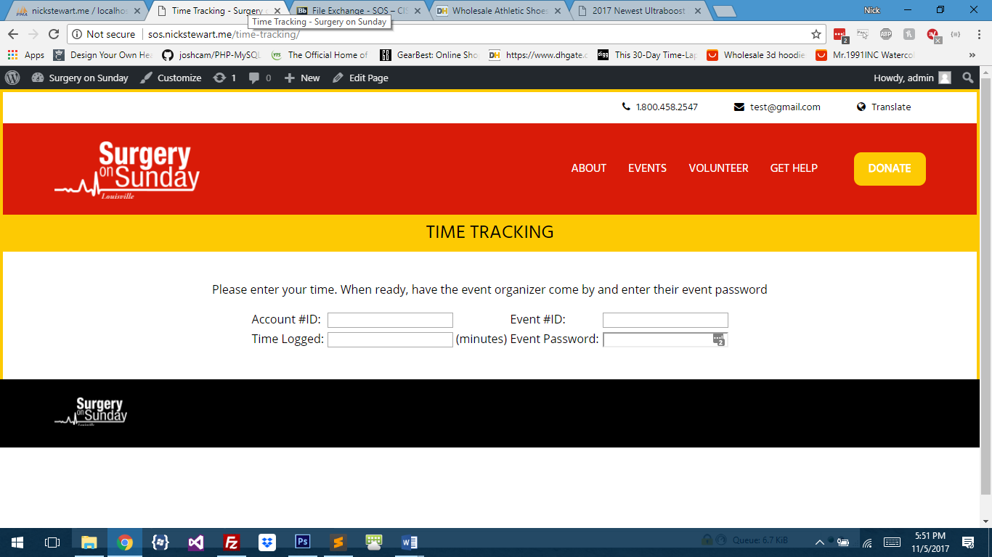
Volunteer Management
Volunteer time tracking

Slide 8
Volunteer Management
Volunteer chooses type

Slide 9
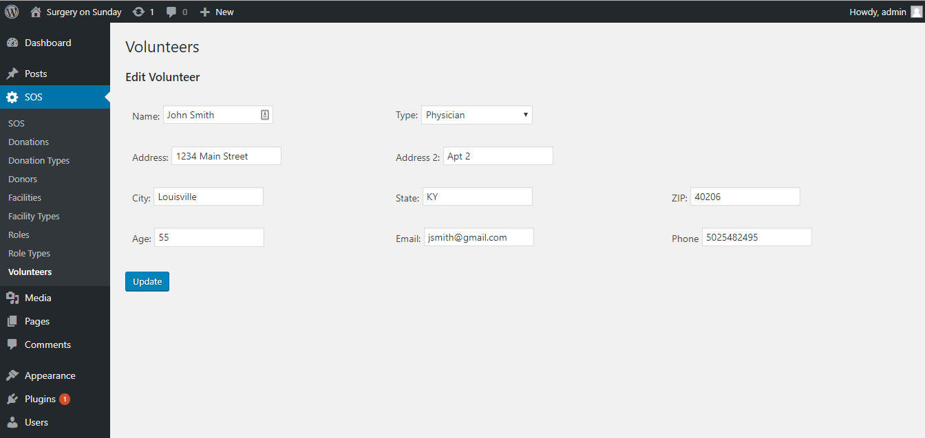
Volunteer Management
Volunteers data management

Slide 10
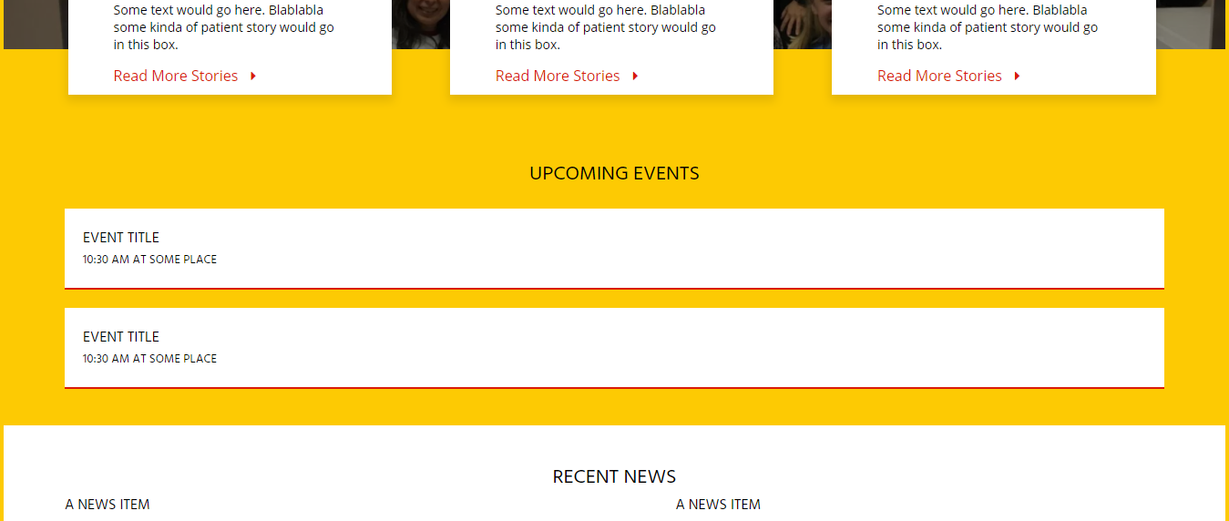
Event Scheduling
Events displayed on the homepage

Slide 11
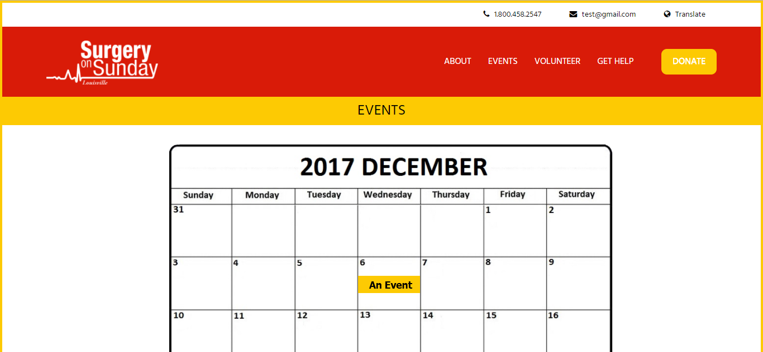
Event Scheduling
Calendar is updated with the event

Slide 12
Patient Testimonials
Patient testimonials are displayed

Slide 13
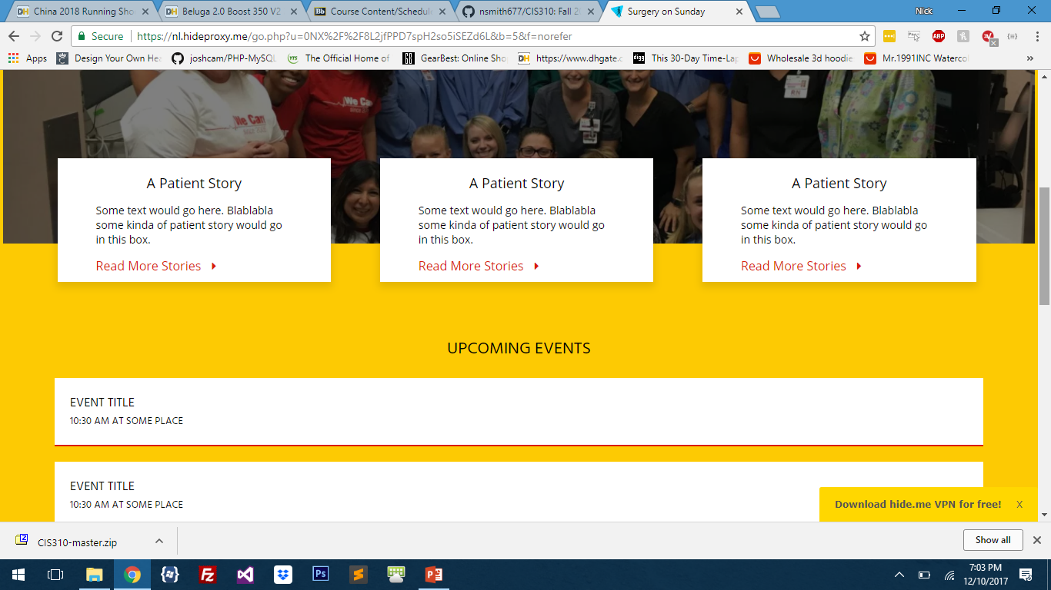
Patient Testimonials
Patient testimonials are displayed

Slide 14
Language Translation
Translate button in upper right corner

Slide 15
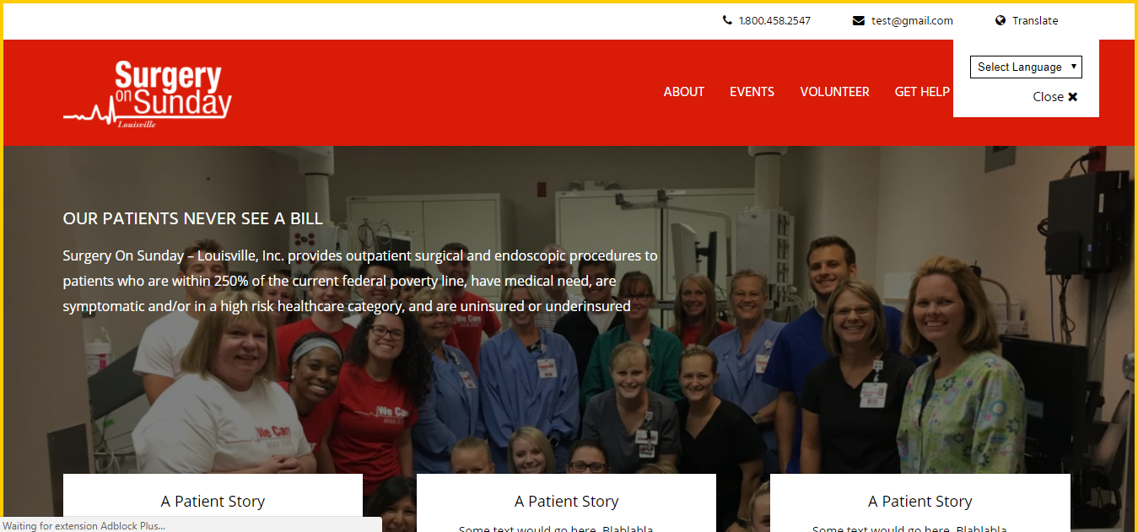
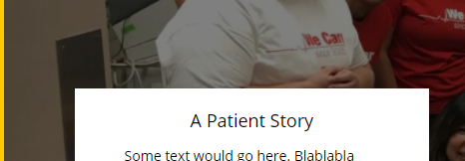
Language Translation
Translate button in upper right corner

Slide 16
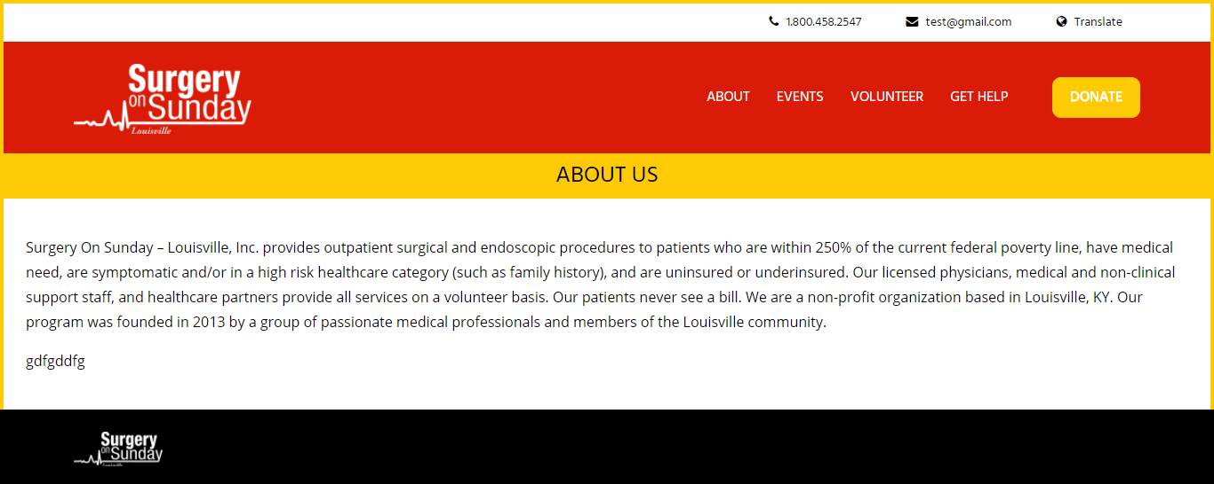
Other Features
About Page

Slide 17
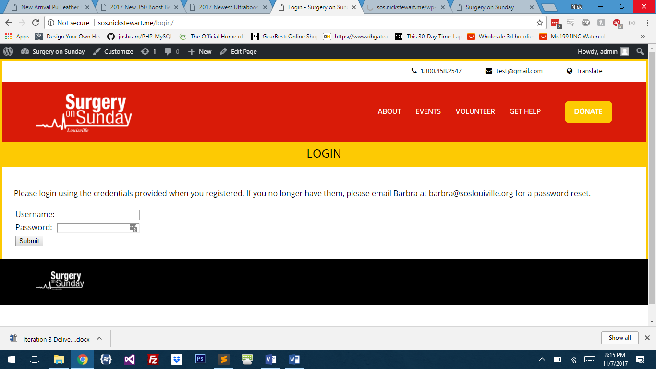
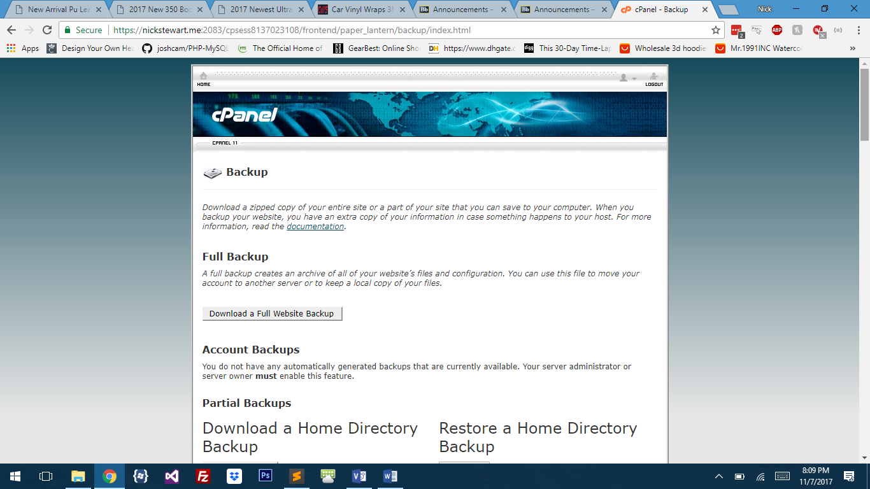
Other Features
Login Screen
Backup

Slide 18
Financial
We estimate that the business will increase both donations and grants by at least 10 percent per year due to the efficiency of the new system. The time that is saved can be dedicated toward grant proposals and fundraising, and a larger social media footprint will grow the number of donors. If we assume a starting point of $20,000 revenue, that would result in approximately $125,000 at the end of five years after adjusting for inflation and determining the present value.

Slide 19
Conclusion
Surgery on Sunday meets an important need in our community. We look forward to the opportunity to improve the system processes in order to grow the business and help you to treat more patients.

